Slide 1
Exploratory Data analysis- Global terrorism

Slide 2
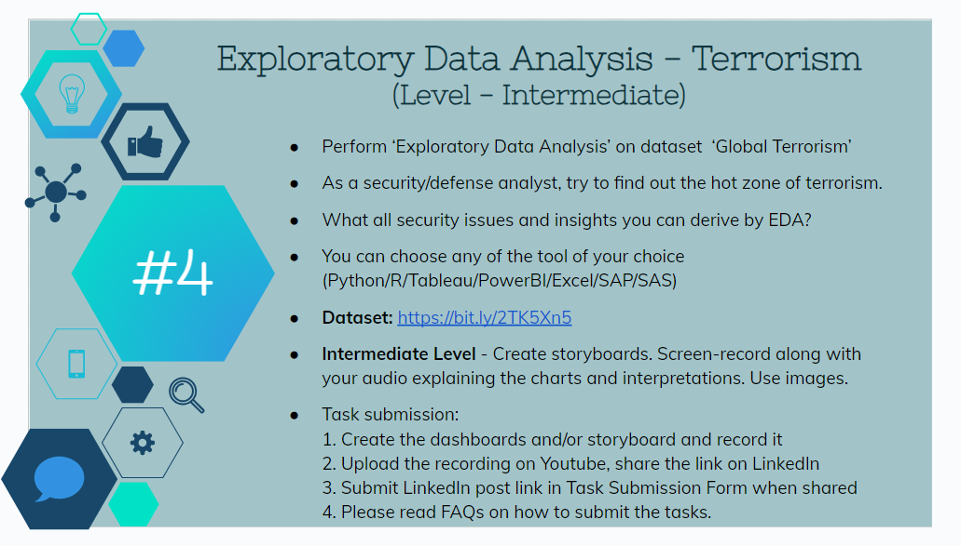

Slide 3
Questions for better analysis:
Which region suffered the most from terrorism?
Top terrorist group by success?
What was the Deadliest Weapon used?
What was the Most preferred attack type?
In which year were there the most attacks?

